Slide 1
Hierarchical Abundance Modeling to Inform Oak Savanna Habitat Restoration

Slide 2
Hierarchical Abundance Modeling to Inform Oak Savanna Habitat Restoration
For Minnesota Species in Greatest Conservation Need

Slide 3
University of Minnesota
Fisheries, Wildlife, Conservation Biology
Minnesota Department of Natural Resources
Nongame Wildlife

Slide 4
USFWS State Wildlife Grants Program
MN Department of Natural Resources
MN Herpetological Society
University of Minnesota
Helen Wagner Charitable Foundation

Slide 5
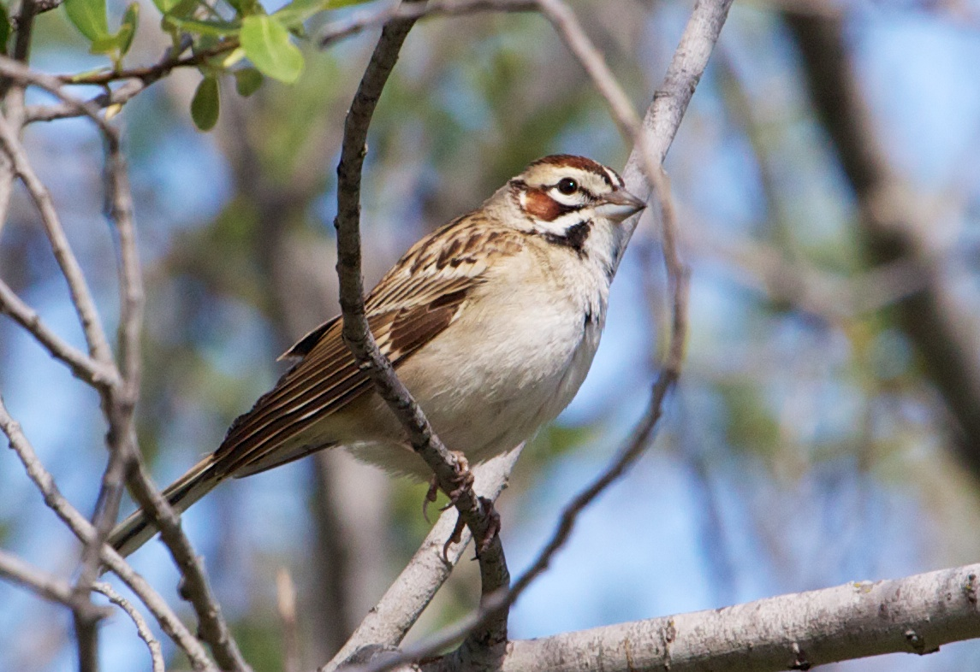
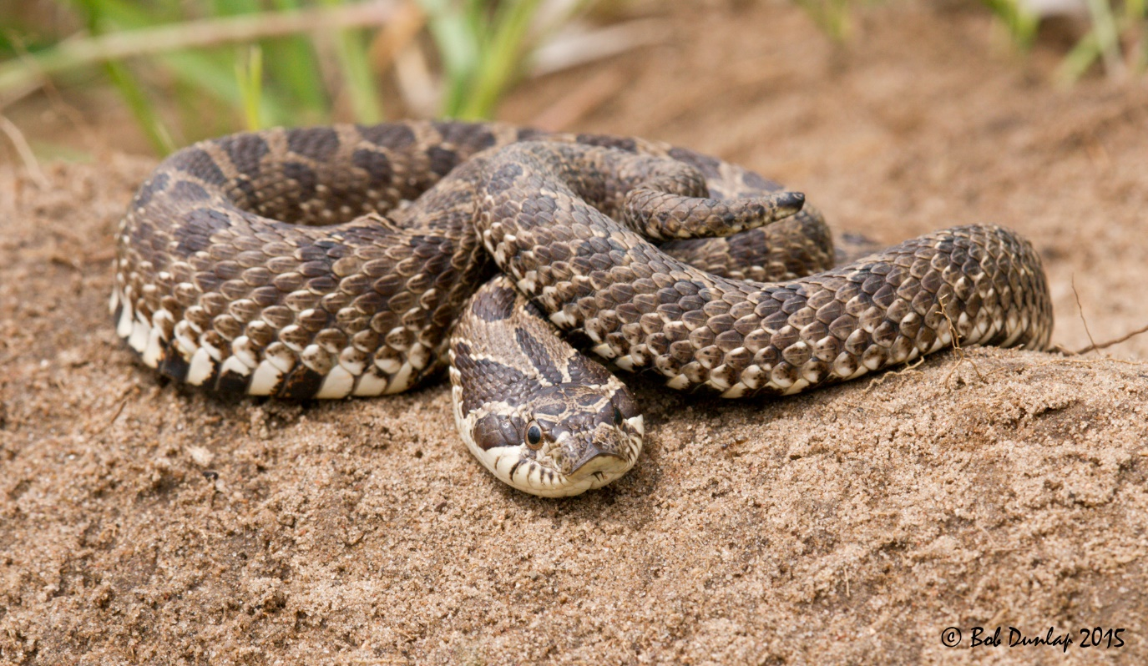
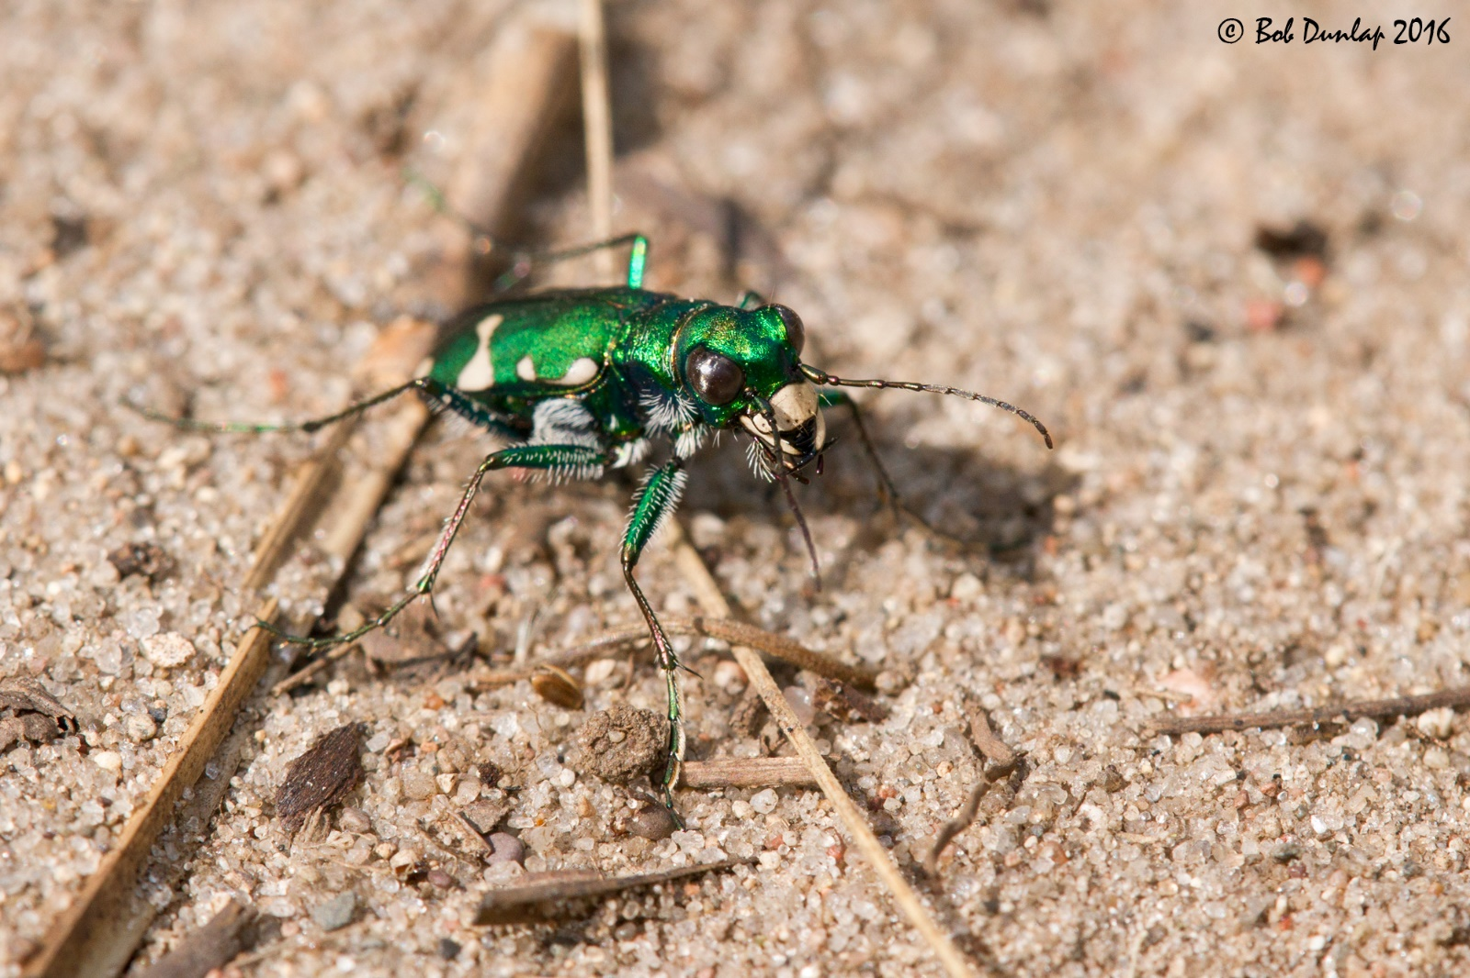
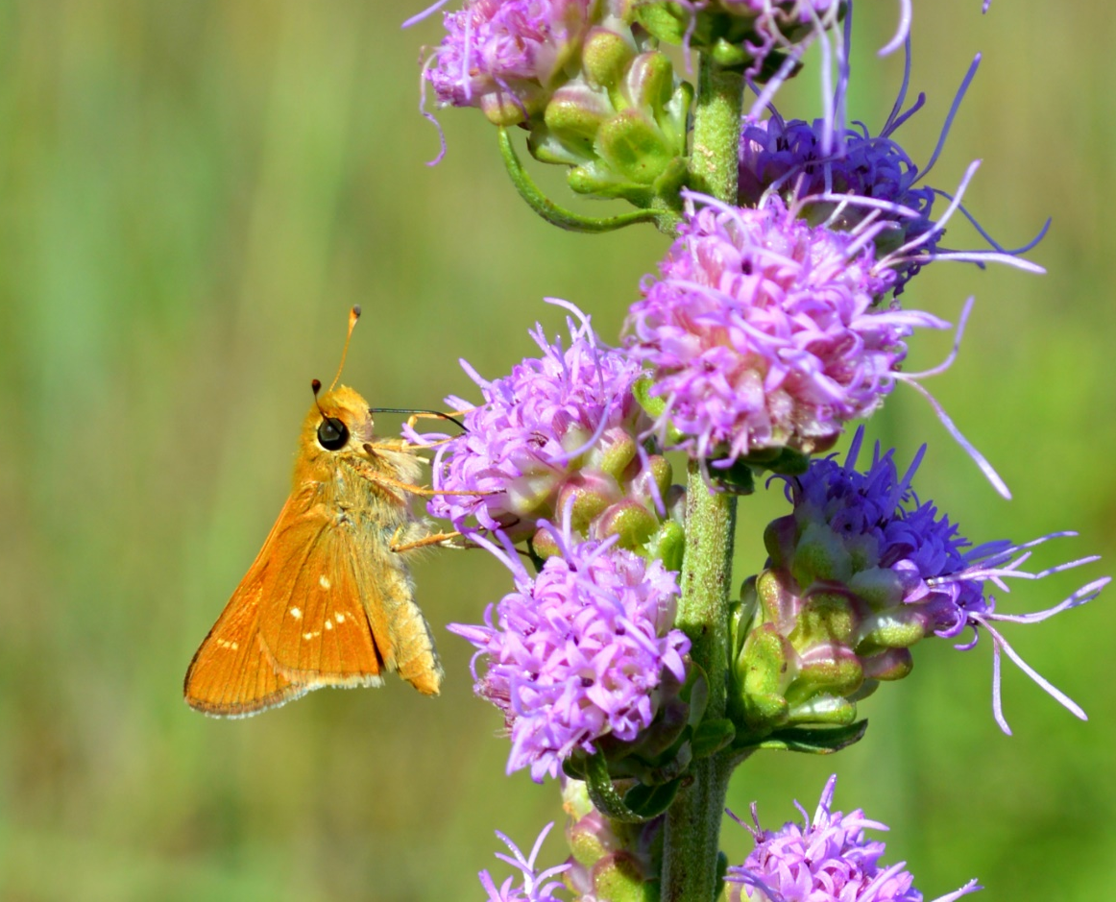

Slide 6
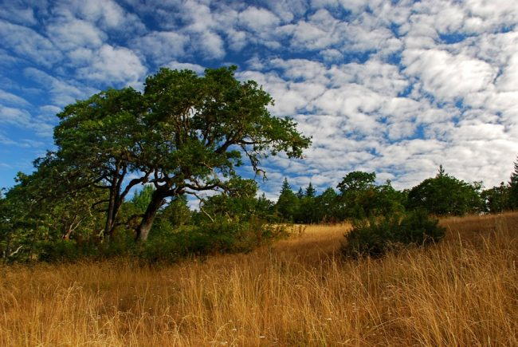

Slide 7
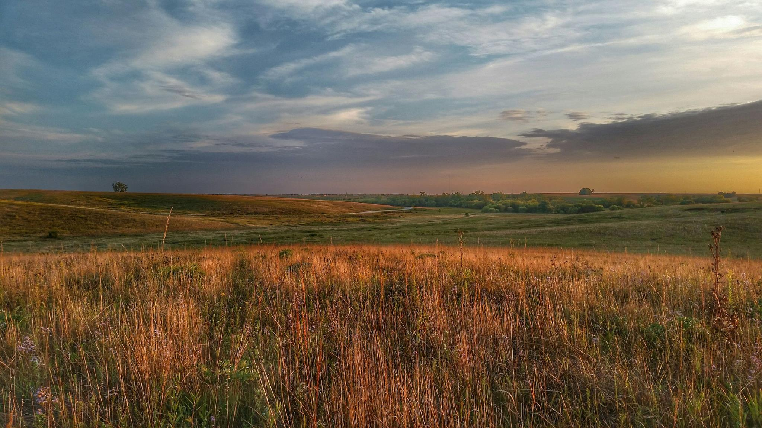

Slide 8
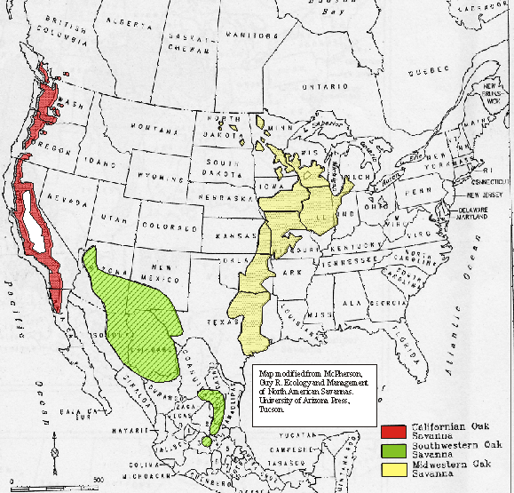
~12,000,000 ha in the Midwest (Nuzzo 1986)

Slide 9
~ 12,000,000 ha
~ 2,600 ha remained
98.98 % loss

Slide 10
~ 12,000,000 ha
~ 2,600 ha remained
< 98.98 %
Nuzzo 1986

Slide 11
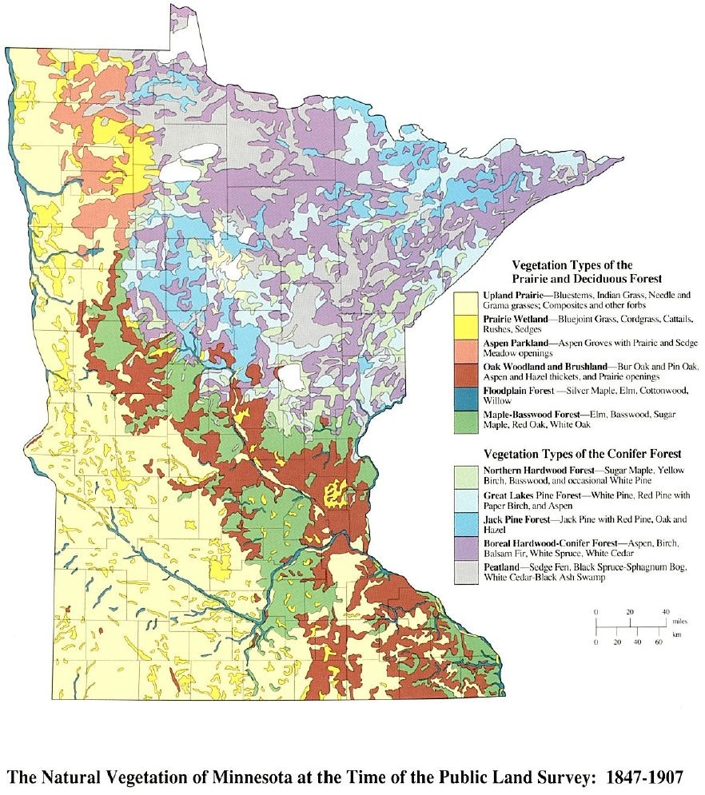
Upland Prairie
Prairie Woodland
Aspen Parkland
Oak Woodland and Brushland
Floodplain Forest
Maple – Basswood Forest
Northern Hardwood Forest
Great Lakes Pine Forest
Jack Pine Forest
Boreal Hardwood - Conifer
Peatland
The Natural Vegetation at the Time of the Public Land Survey: 1847-1907
Adapted by Barbara Coffin from The Original Vegetation of Minnesota by F. J. Marschner, pub. 1974.

Slide 12
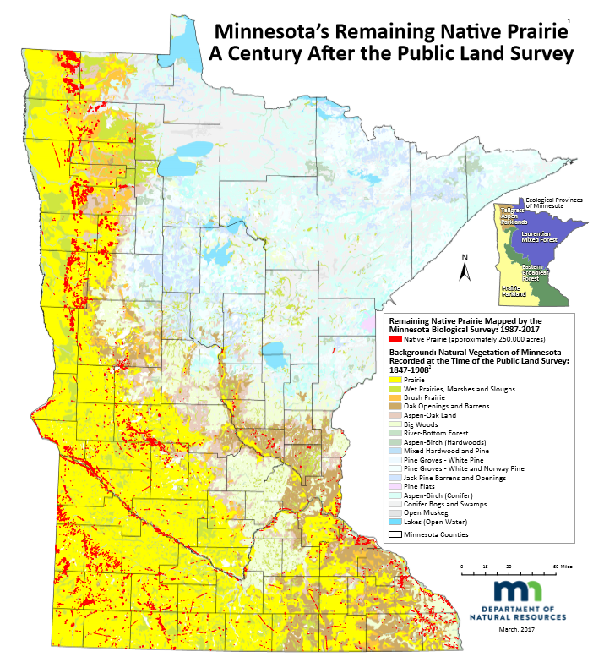

Slide 13
Anoka sand plain

Slide 14
2006 SWAP

Slide 15
Sand Dunes State Forest
Location, history. Land use,
Size, proportions of area.

Slide 16
Sand Dunes State Forest
Rare features.

Slide 17
Habitat Restoration
Increase available habitat
Improve habitat quality and connectivity
Permanent management for rare plant and animal species

Slide 18
Habitat Restoration
Ecologically appropriate native plant communities
Immediate Conversion Areas: 255 ha
Eventual Conversion Areas: 537 ha

Slide 19
Habitat Restoration
Burning
Selective timber harvest
Invasive species control

Slide 20
Habitat Restoration
Broad ecosystem health
Rare features management

Slide 21
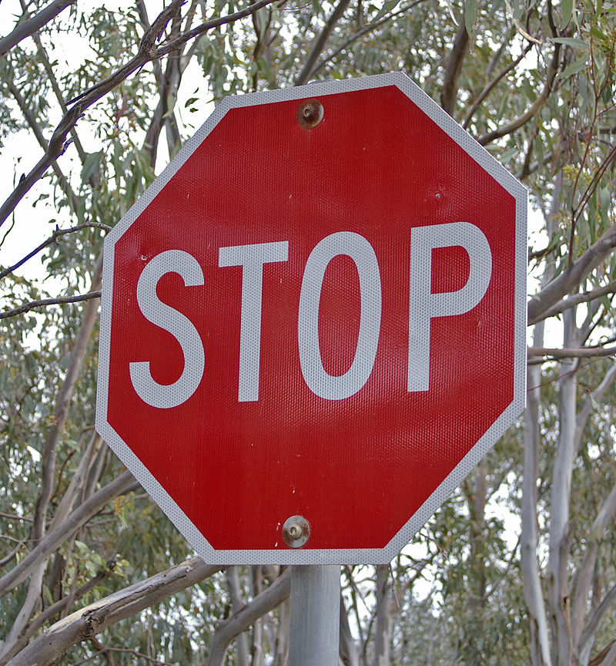
What constitutes success?
What does progress look like?

Slide 22


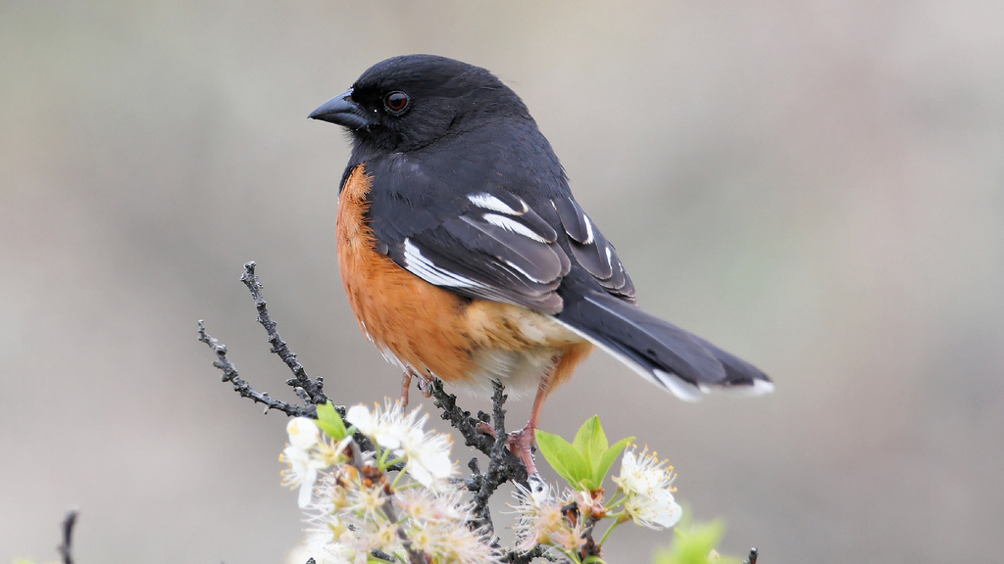
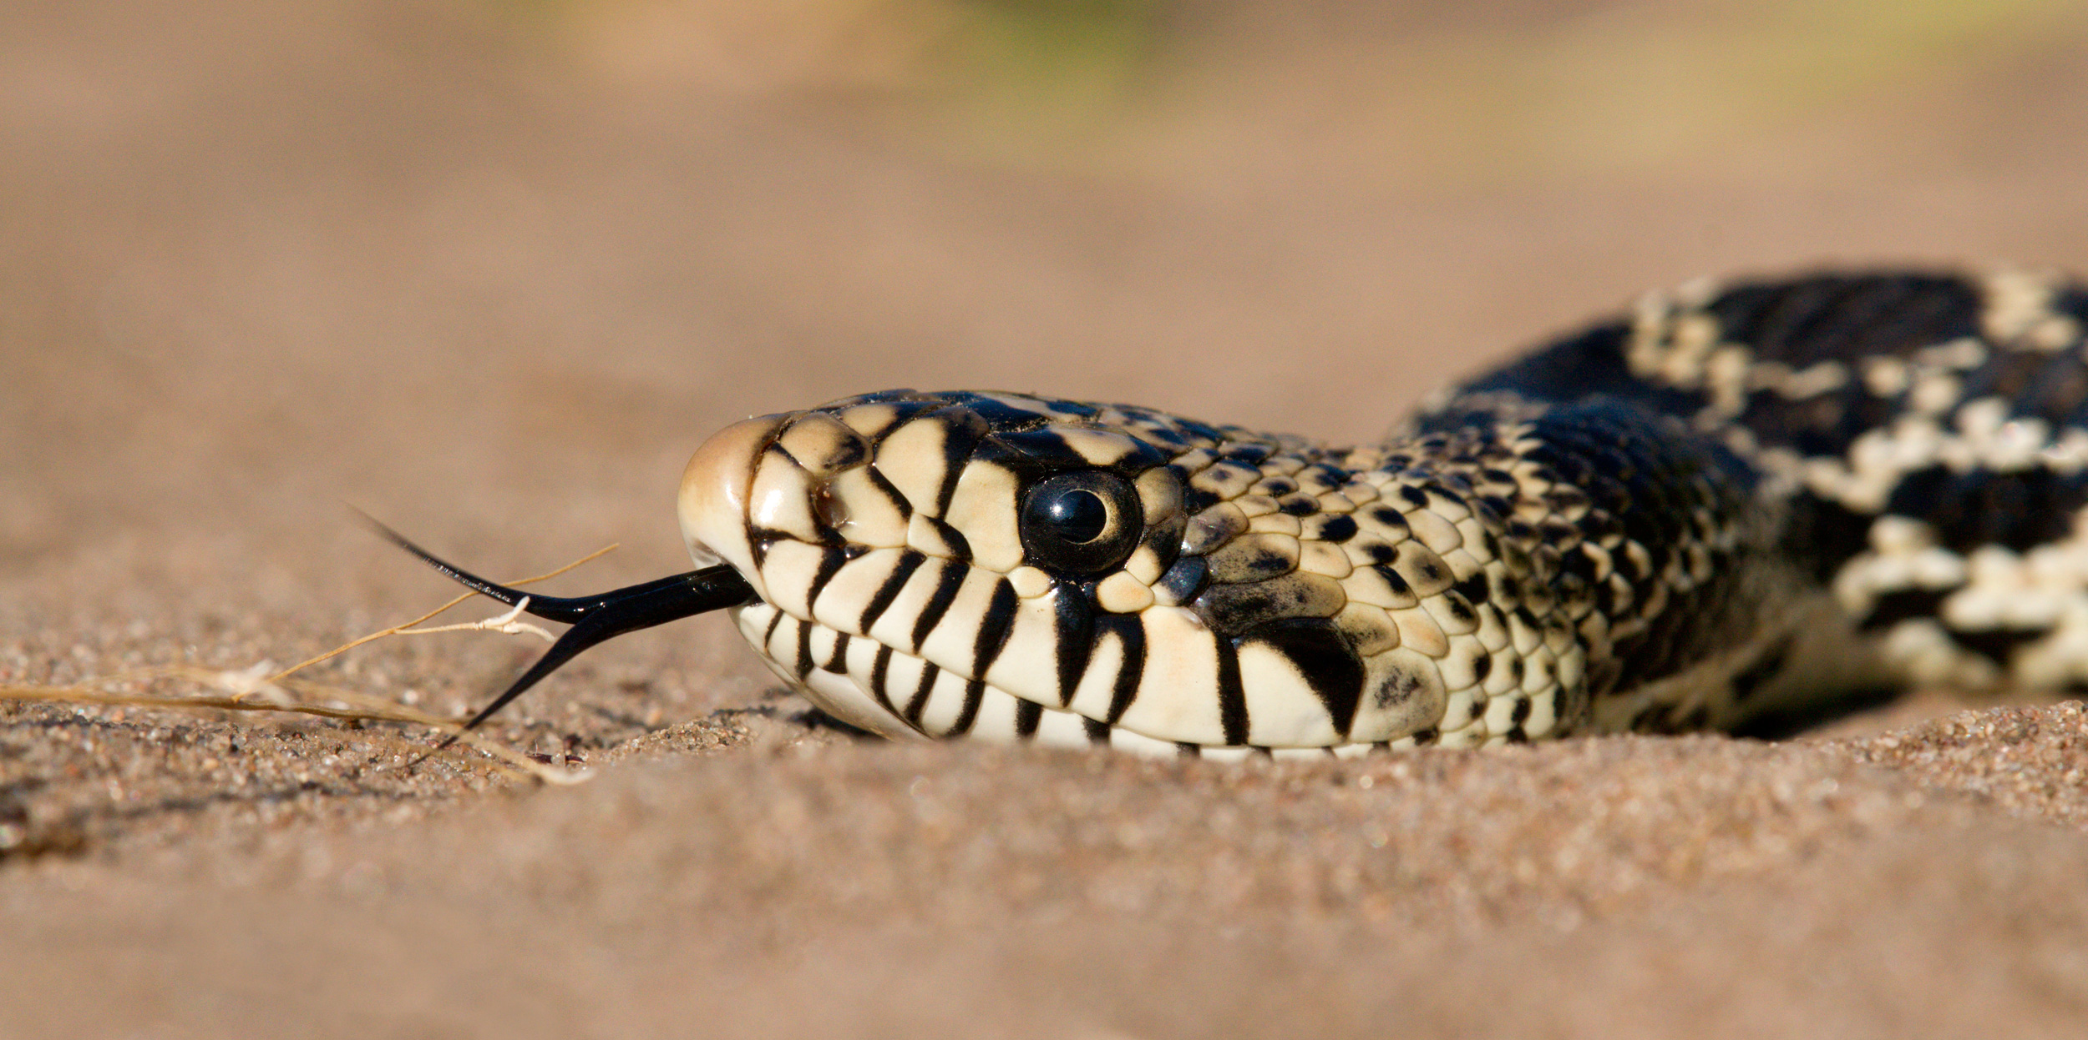

Notes:
These are species that evolved along with the native habitats that we are trying to restore. So, we can use their collective distribution, abundance, and response to management as a way to inform restoration.

Slide 24
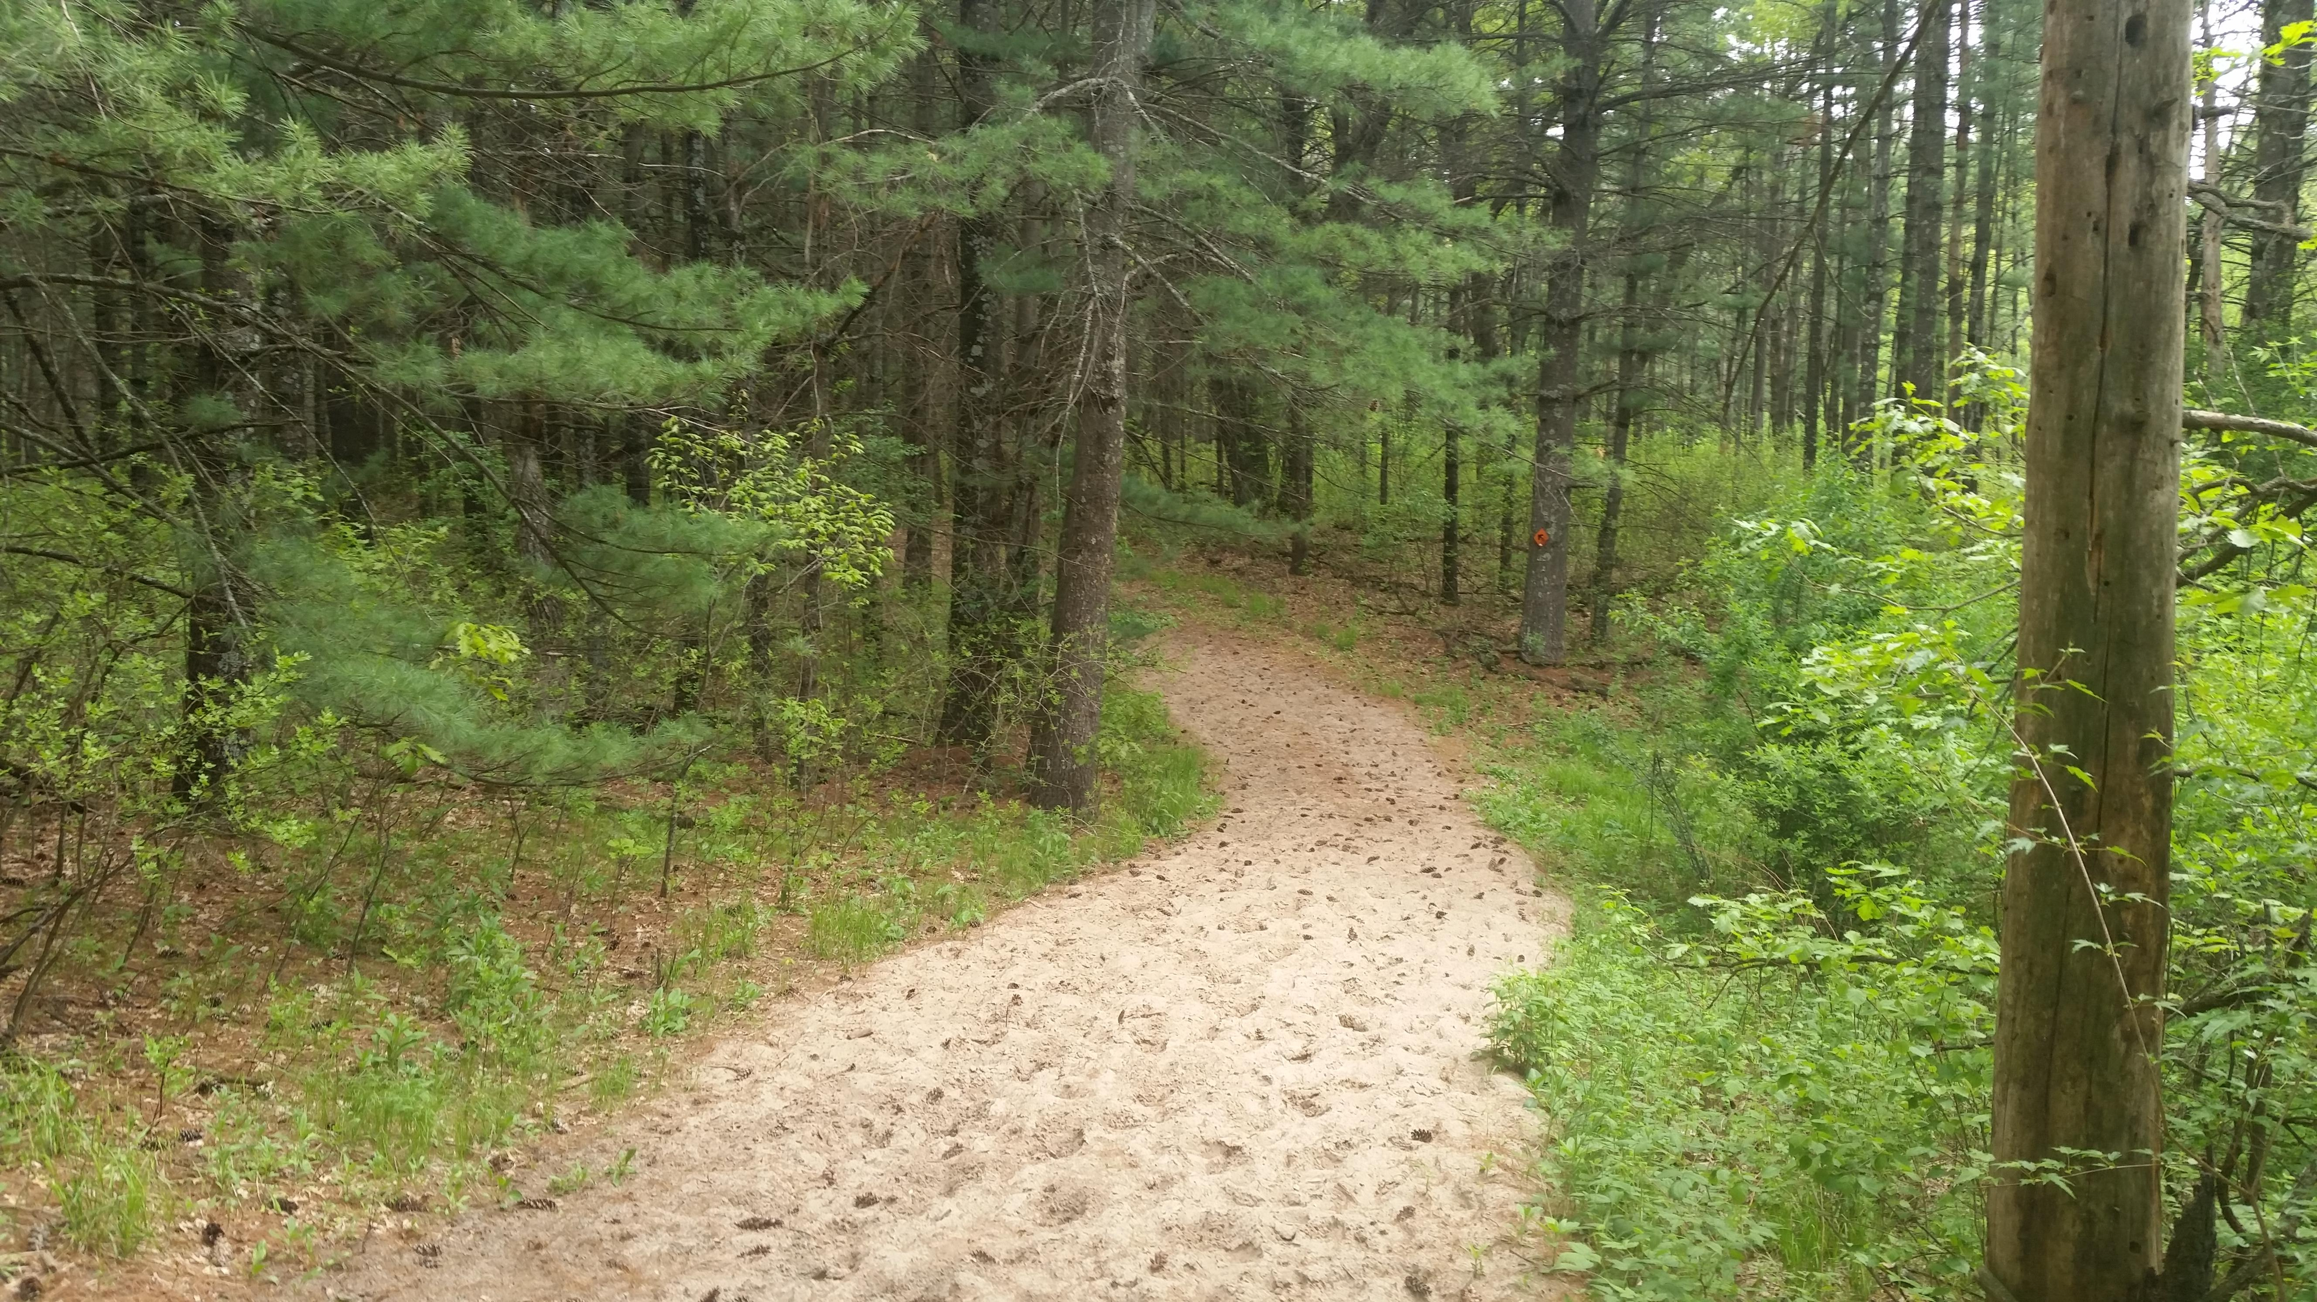

Slide 25
Notes box
Twenty point text
Twenty-four point text
Twenty-eight point text
Thirty-two point text
Thirty-six point text
Forty-four point text
Forty-eight point text

Slide 26
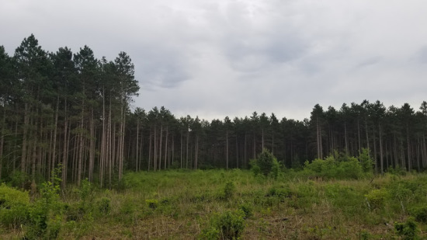

Slide 35
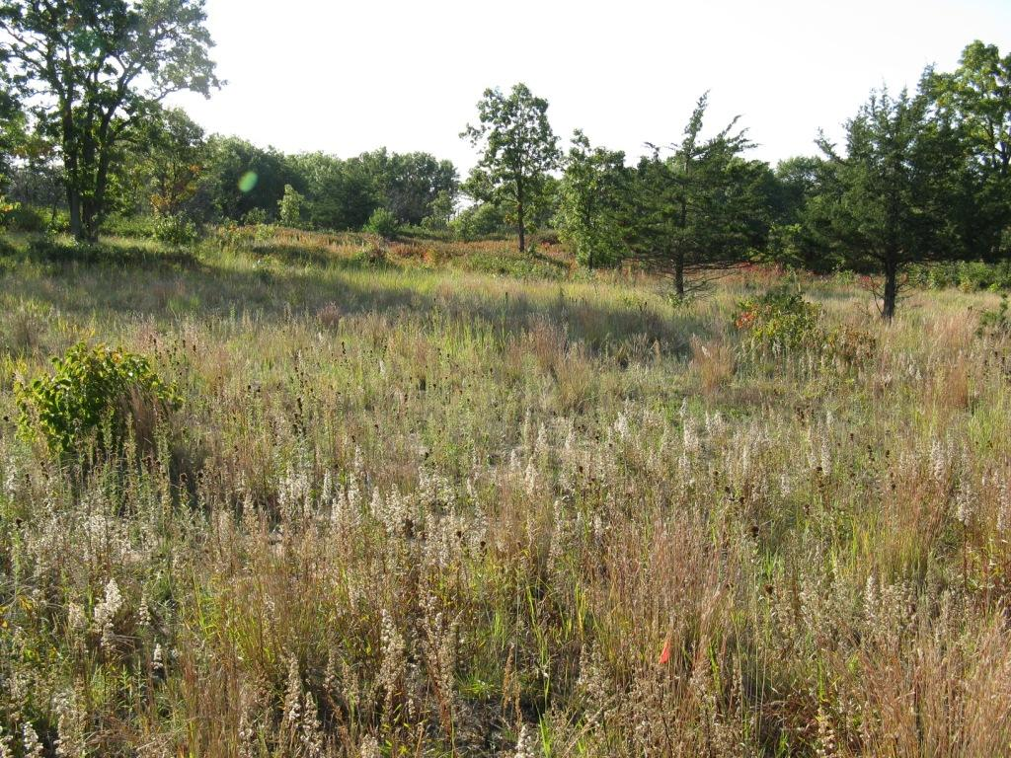

Slide 36
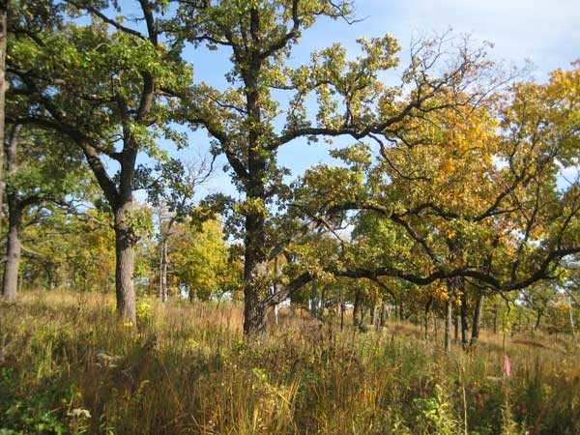

Slide 37
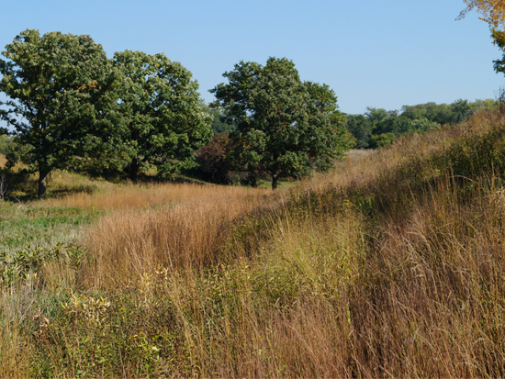

Slide 38
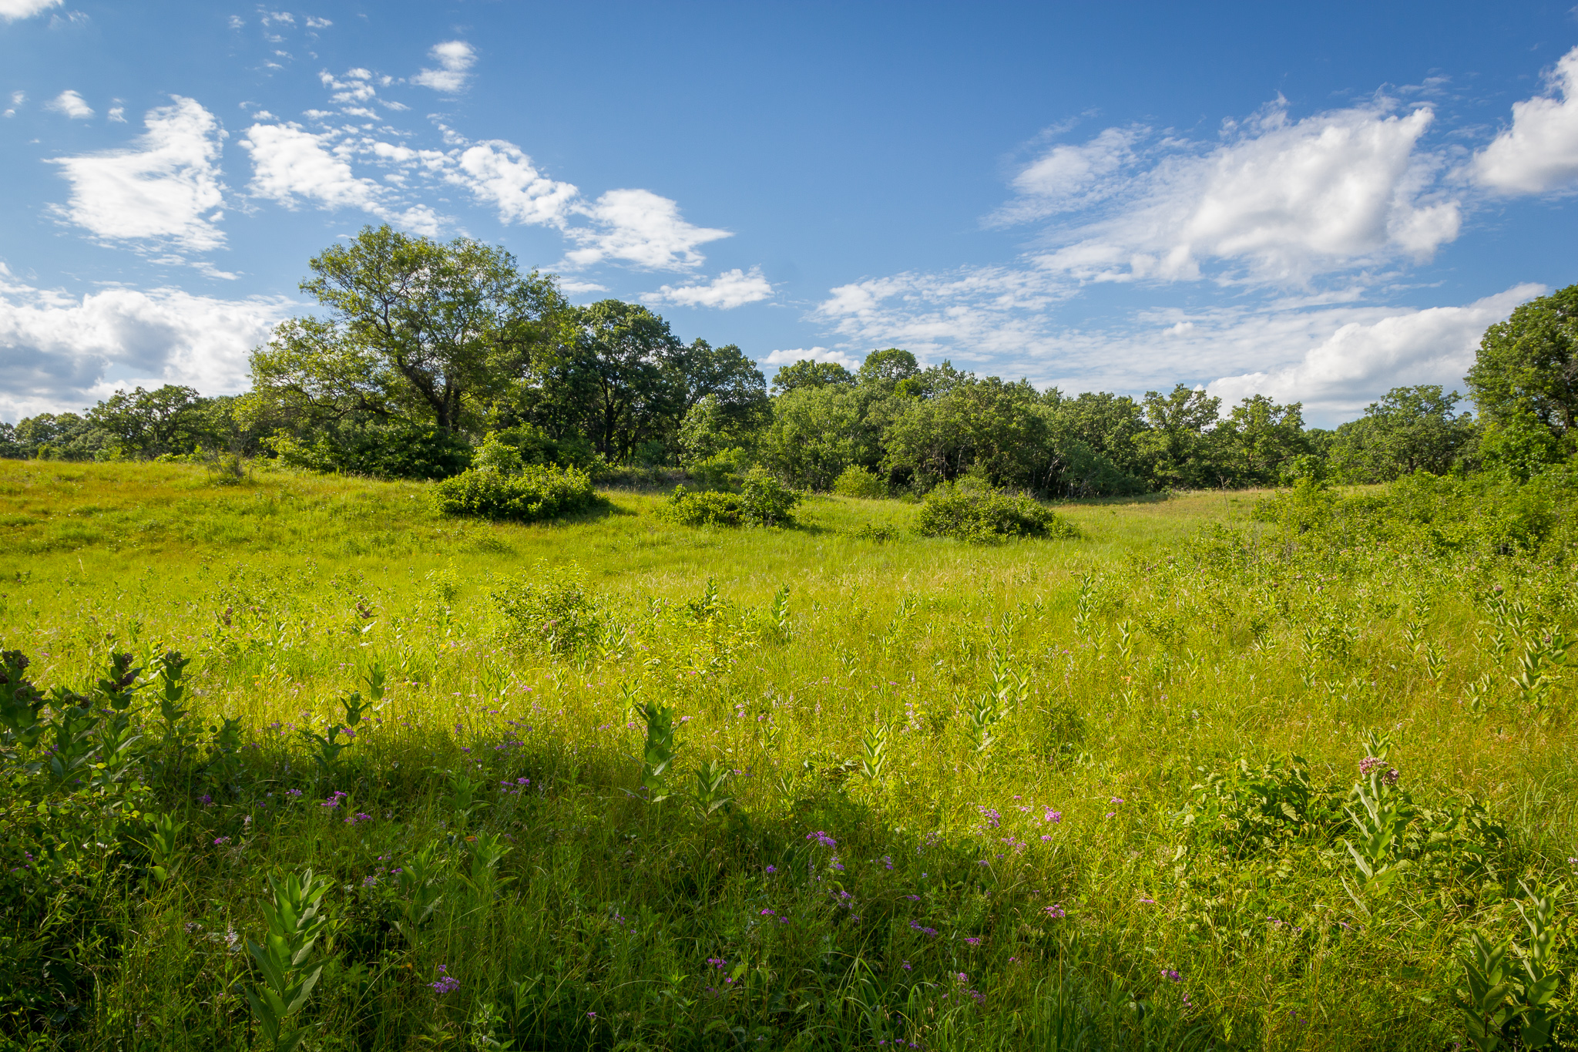

Slide 39
